Slide 1

CMU Portugal
Advanced Training Program
Multimodal Conversational AI and Generative AI
JOÃO MAGALHÃES
NOVA SCHOOL OF SCIENCE AND TECHNOLOGY
VASCO RAMOS
NOVA SCHOOL OF SCIENCE AND TECHNOLOGY
BRUNO MARTINS
INSTITUTO SUPERIOR TÉCNICO

Slide 2
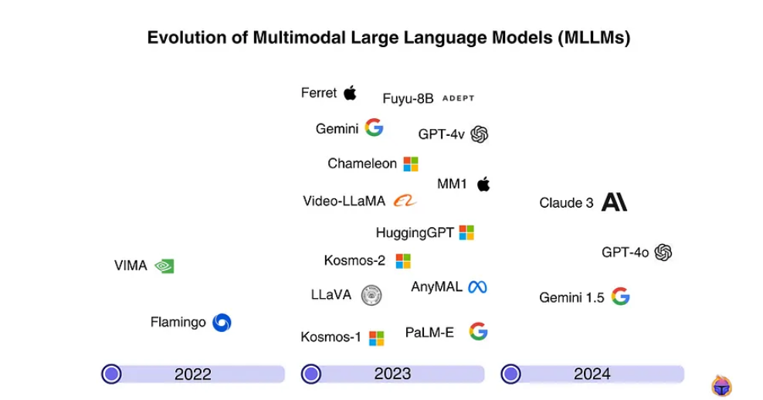
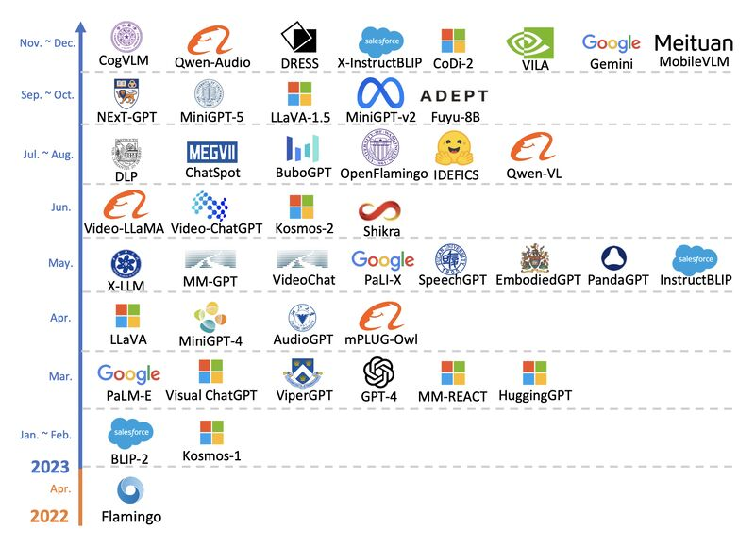
The Rise of Multimodal Large Language Models (MLLMs)
MLLMs are models that process and integrate multiple types of data modalities.
Text
Images
Audio
Sensory Data
2

Slide 3
MLLMs: Why should we care?
These models enable “more natural” interactions and allow for advanced problem-solving capabilities that combine different types of information!
Document Analysis
Extracting both textual and visual information from documents (e.g., CV analysis).
Healthcare
Combining medical imaging with patient records to improve diagnostics.
Autonomous Systems
Assists in navigation by integrating visual, auditory and textual cues (e.g., autonomous driving systems).
Content Creation & Digital Art
Generating or editing images based on textual inputs.
3

Slide 4
Overview
Introduction
MLLM Architectures
Model Training and Evaluation
Exercises
4

Slide 5

The Architecture of MLLMs: Components
Modality Encoder
Text Encoder
Vision Encoder
Audio Encoder
Video Encoder
2. Modality Integration
Adapters/Connectors, often involves the integration with an LLM
3. Decoder
Generates the final output. Often a pre-trained LLM!
5

Slide 6
The Architecture of MLLMs: Modality Encoders
Text Encoder
Vision Encoder
Converts images into feature representations compatible with text
Converts textual input to dense vector representations
Examples:
GPT
LLaMA
Qwen
Examples:
ViT
Swin Transformer
CLIP’s vision encoder
MLLMs are often built on top of a pre-trained LLM:
The text encoder is typically the one already present in the LLM
6

Slide 7
The Architecture of MLLMs: Modality Encoders
Audio Encoder
Video Encoder
Converts raw audio into text embeddings or direct speech representations.
Captures both spatial and temporal information
Examples:
Whisper
Wav2Vec
HuBERT
Spectrogram Transformer
Examples:
TimeSformer
VideoPrism
VideoMAE
FitCLIP
7

Slide 8




The Architecture of MLLMs: Bridging the Modality Gap
How can we integrate different modalities with a pre-trained LLM?
LLMs only process text so we need to find ways to connect them to all other modalities - We need to bridge the modality gap!
Learnable Connectors
Shared representation
Expert Models
8

Slide 9
Bridging the Modality Gap: Learnable Connectors
Goal: Adapt non-text modalities by projecting the information into a space the LLM can understand and use.
Based on how multimodal information is fused, connectors can be implemented at:
Token-Level
Feature-Level
Encoder outputs are transformed into tokens and concatenated with text tokens before being sent into LLMs.
Inserts extra modules that enable deep interaction between modalities.
9

Slide 10
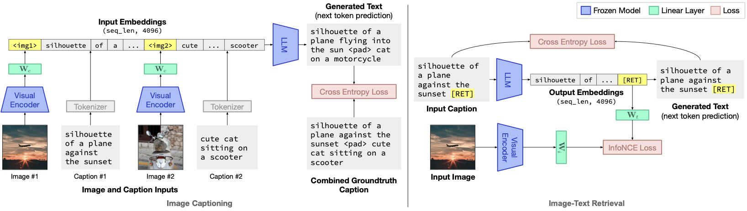
FROMAGe
Learnable Connectors: Token-Level
FROMAGe is trained on image-text pairs for captioning and image-text retrieval, using learnable mappings for individual tokens that represent image contents.
Koh et al., Grounding Language Models to Images for Multimodal Inputs and Outputs.
ICML 2023.
10

Slide 11
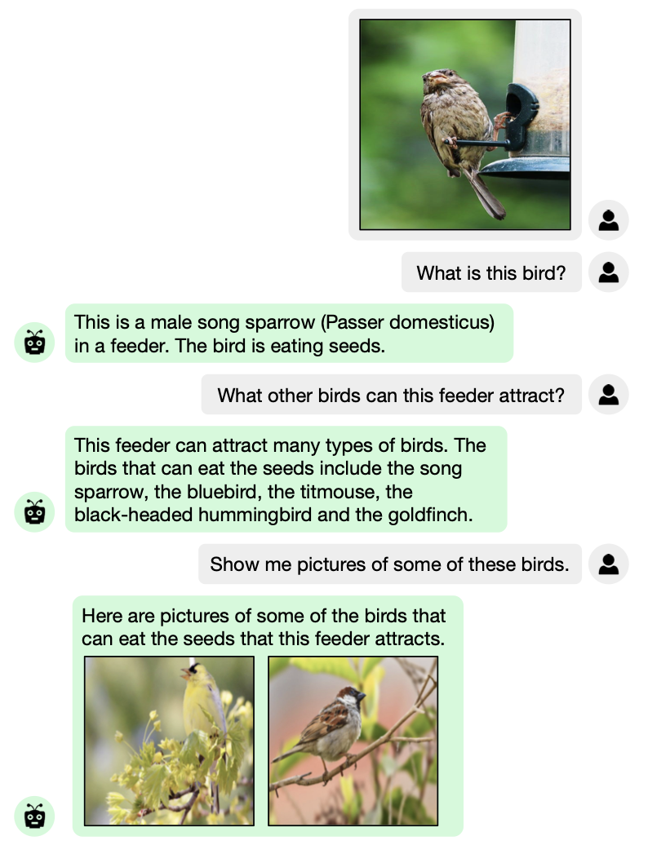
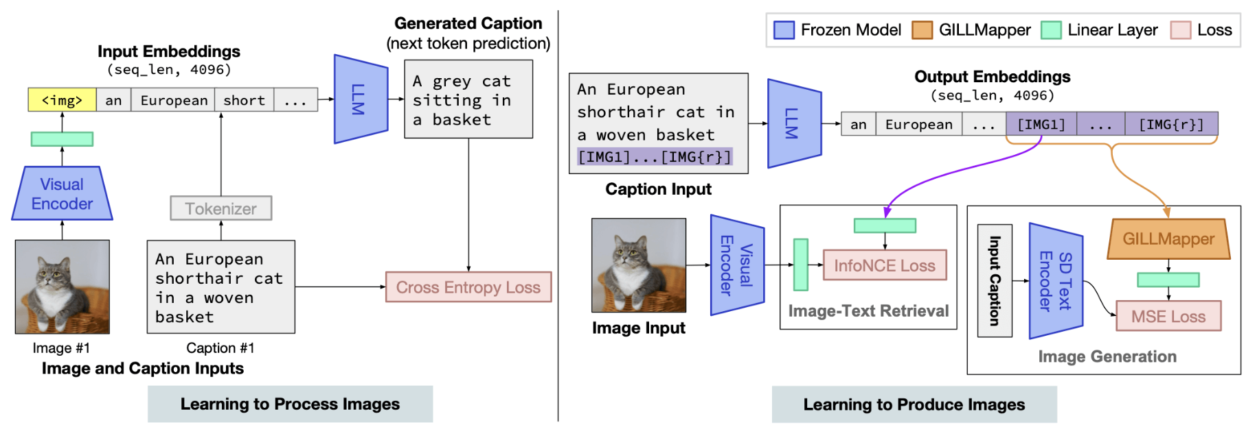
GILL
Learnable Connectors: Token-Level
Generating Images with Large Language Models (GILL) extends FROMAGe with the capability to generate novel images.
Koh et al., Generating Images with Multimodal Language Models.
NeurIPS 2023.
11

Slide 12
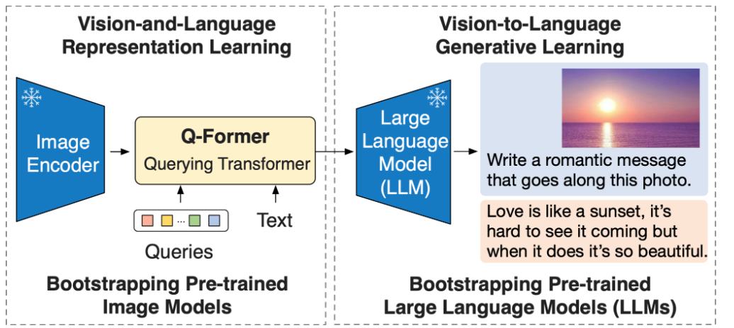
BLIP-2 and
InstructBLIP
Learnable Connectors: Token-Level
Q-Former: Similar to DETR, involves a set of learnable query embeddings that attend to the images features through cross-attention.
Each query learns to extract specific types of visual information.
The processed queries become a smaller and more focused set of visual tokens.
Dai et al., InstructBLIP: Towards General-purpose Vision-Language Models with Instruction Tuning.
NeurIPS 2023.
12

Slide 13
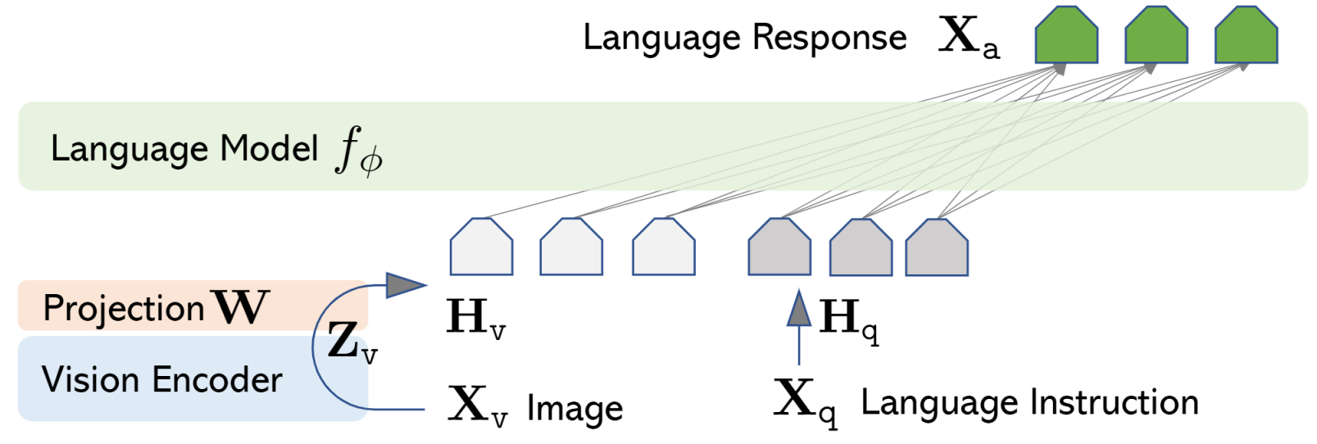
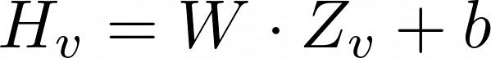
LLaVA et al.
Learnable Connectors: Token-Level
MLP Adapters: Models like LLaVA or PaliGemma use a MLP module to project multiple visual features into the same embedding space as text.
Trained on image-text pairs!
Liu et al., Visual instruction tuning.
NeurIPS 2023.
Beyer et al., PaliGemma: A versatile 3B VLM for transfer
Google Technical Report 2024
13

Slide 14
Many Extensions over LLaVA and Similar Models
Llava et al.
Increased resolution of input images (LLaVA-NeXT).
Better handling of small objects and OCR.
Improved reasoning and few-show learning abilities (LLaVA-NeXT).
More diverse instruction data.
Combination with external OCR tools (LLaVA-Read).
Specialized encoders for high-resolution images and visual-text.
Instruction prompts featuring task descriptions plus OCR text.
Better handling image sequences and video (LLaVA-OneVision).
Liu et al., Visual instruction tuning.
NeurIPS 2023.
14

Slide 15
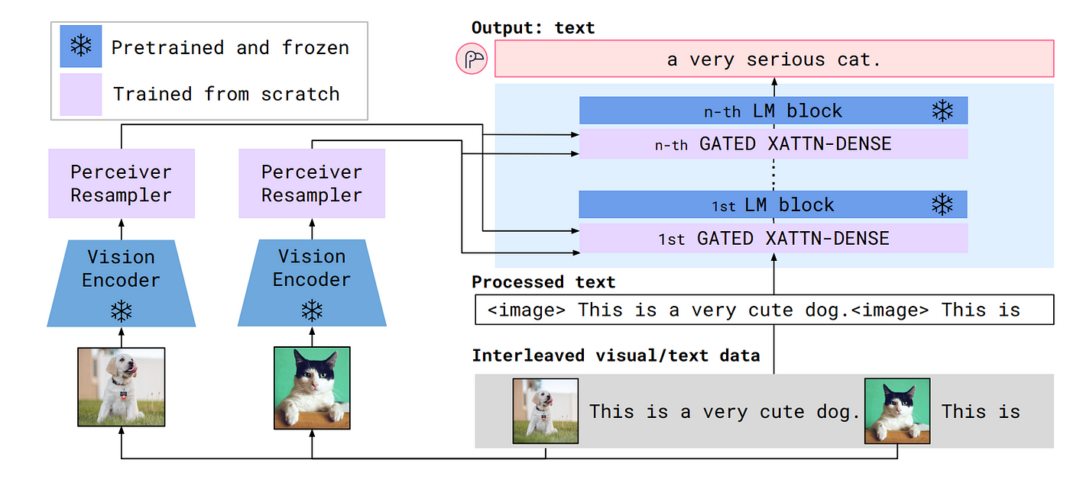
Flamingo
Learnable Connectors: Feature-Level
Cross-Attention: Enables deep interaction between modalities by inserting extra layers between the frozen LLM and the vision inputs.
Instead of adapting the vision/audio features to fit the LLM, cross-attention layers allow the LLM to process them as contextual information.
Alayrac et al., Flamingo: a Visual Language Model for Few-Shot Learning.
NeurIPS 2022.
15

Slide 16
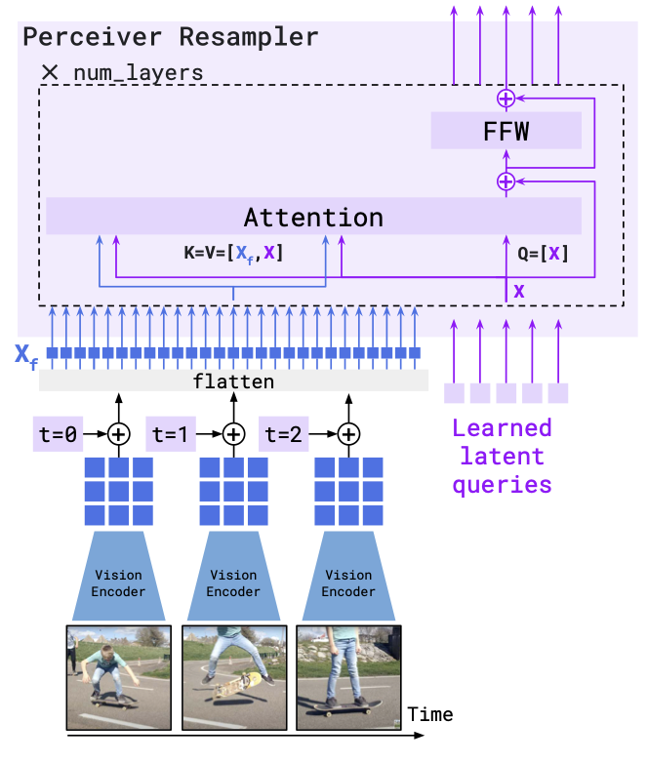
Flamingo
Learnable Connectors: Feature-Level
The Perceiver Resampler module maps a variable size grid of spatio-temporal visual features, output by the vision encoder, to a fixed number of output tokens, independently from the input image resolution or the number of input video frames.
Similar to DETR model. Uses learned latent vectors as queries, and the keys and values are a concatenation of the visual features.
16

Slide 17
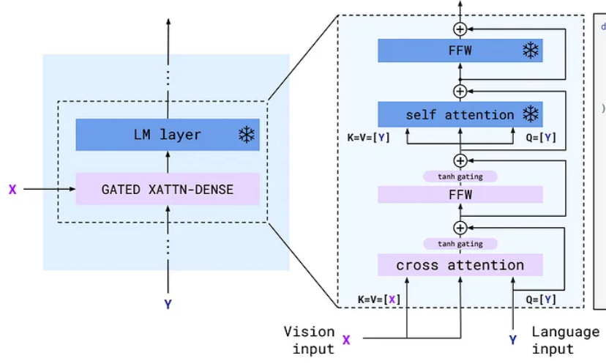
Flamingo
Learnable Connectors: Feature-Level
Recall Transformer encoder-decoder models, featuring cross-attention!
Flamingo leverages a gated cross-attention mechanism: it allows to selectively control how much should the visual content influence the text representation.
17

Slide 18
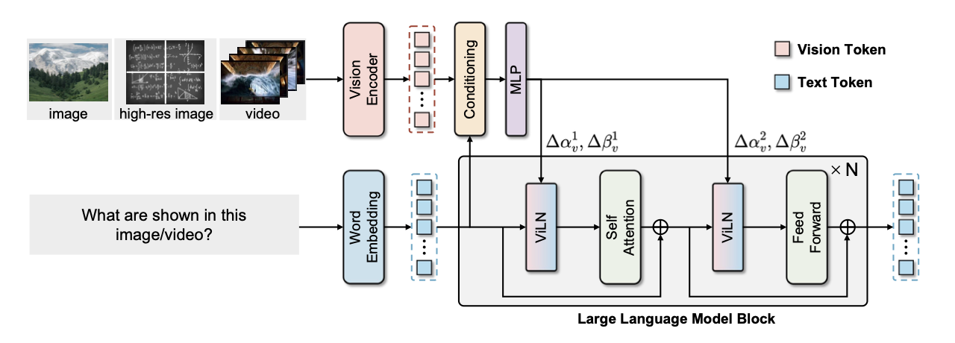
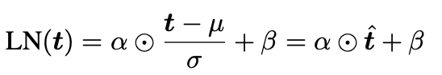
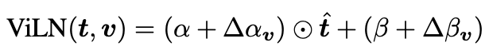
LaVi
Learnable Connectors: Feature-Level
LLM internal feature modulation by injecting token-wise vision-conditioned deltas into the affine parameters of layer normalization.
Instead of cross-attention layers, using the layer normalization operations better preserves the LLM linguistic priors and reduces computational costs.
Yue et al., LaVi: Efficient Large Vision-Language Models via Internal Feature Modulation.
ICLR 2026.
18

Slide 19
Learnable Connectors: Mixing Token- and Feature-Level
Visual Expert Module as a Feature-Level Connector: Trainable visual processing unit directly inserted inside the transformer blocks of the LLM. Allows the model to process the multimodal context across all transformer layers.
19

Slide 20
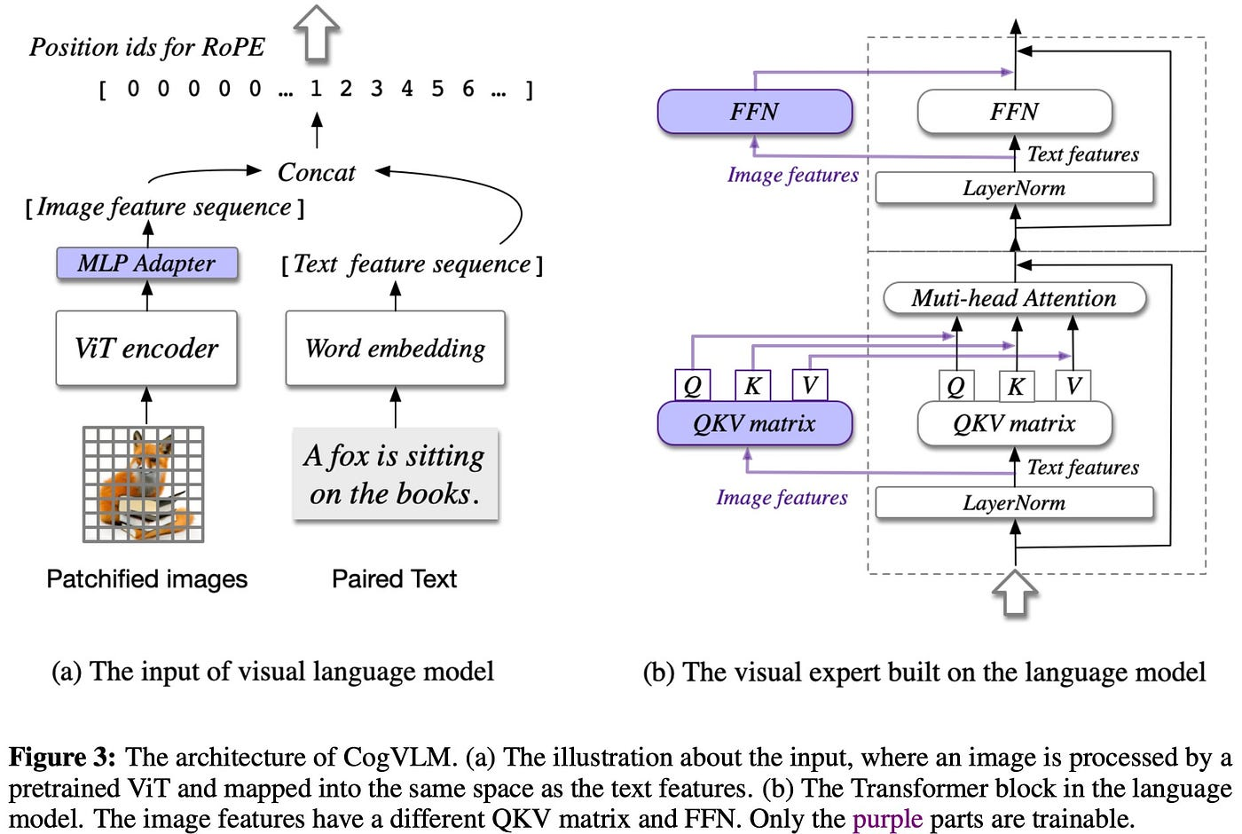
Feature-Level
CogVLM
Image features are processed through a separate set of QKV matrices, specifically dedicated to visual tokens.
Token-Level
Wang et al., CogVLM: Visual Expert for Pretrained Language Models
NeurIPS 2024
20

Slide 21
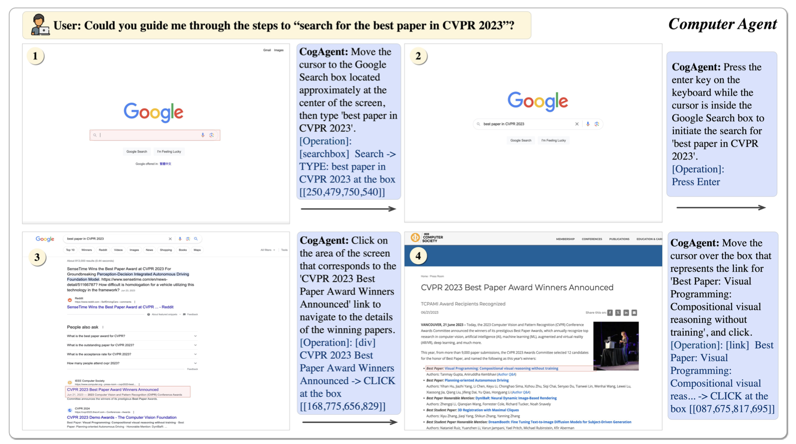
CogAgent
Learnable Connectors: Mixing Levels
On top of the capabilities of the CogVLM model, CogAgent further possesses GUI image agent capabilities.
Hong et al., CogAgent: A Visual Language Model for GUI Agents
CVPR 2024
21

Slide 22
Bridging the Modality Gap: Expert Modules
Goal: Convert multimodal inputs to language without the need for training.
Expert modules (e.g., an OCR model that analyses images and extracts text) are pre-trained, task-specific models that will process a specific modality to convert it into a textual representation, before passing it to the LLM.
Works well for applications like video-to-text or speech-to-text.
Information Loss
Text cannot fully represent spatial or temporal relationships
22

Slide 23
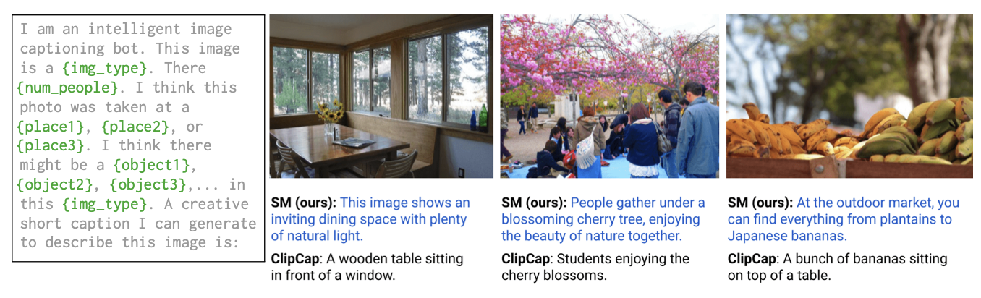
Socratic Models
Expert Modules: Socratic Framework
Socratic Models is a framework in which multiple pretrained models may be composed through language (via prompting) without requiring training, to perform new downstream multimodal tasks (e.g., captioning, robot perception and planning, ...)
Zheng et al., Socratic Models: Composing Zero-Shot Multimodal Reasoning with Language.
ICLR 2023
23

Slide 24
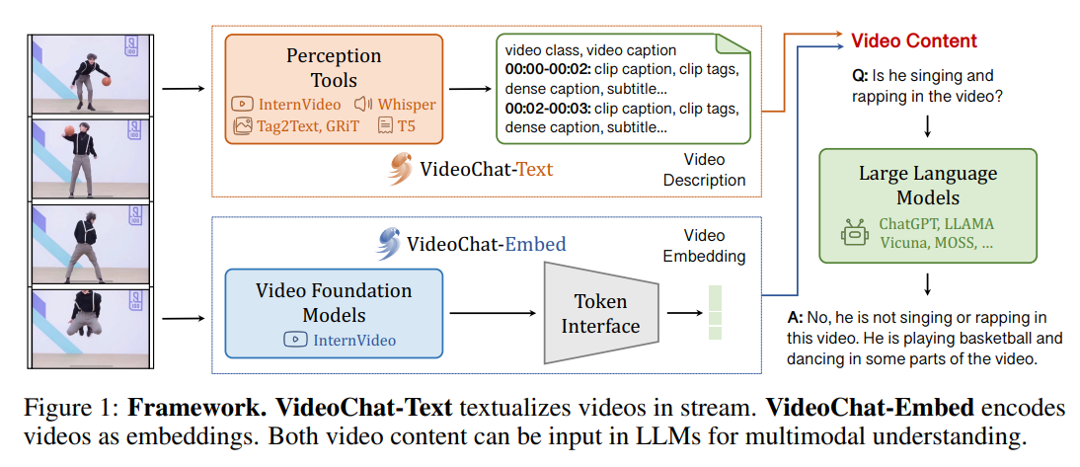
VideoChat
Expert Modules: VideoChat
The VideoChat architecture attempts to bypass the information loss limitation of expert modules by also including video embeddings as input, in order to improve spatial-temporal reasoning
Li et al., VideoChat: Chat-Centric Video Understanding.
arXiv preprint arXiv:2305.06355, 2023.
24

Slide 25
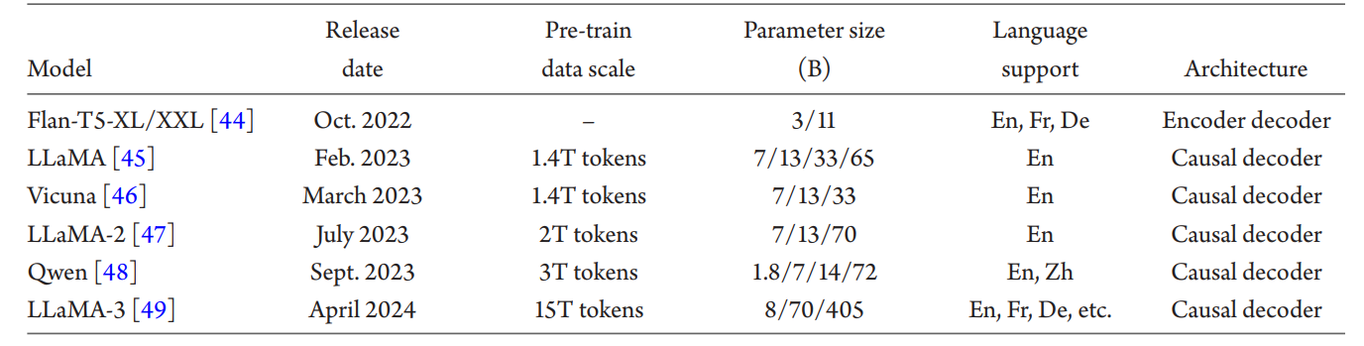
The Architecture of MLLMs: The pre-trained LLMs
Scaling up in parameters usually leads to better performance
Autoregressive generation
25

Slide 26
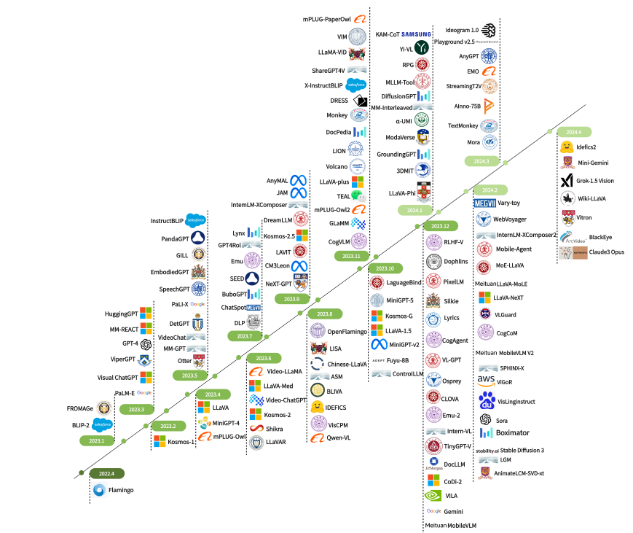
A World of MLLMs
The field has seen exponential growth in the number of MLLMs, with many models building upon the previous architectures.
From task-specific to generalized tasks!
26

Slide 27


Exercise Time
https://huggingface.co/blog/paligemma
https://colab.research.google.com/drive/1gOhRCFyt9yIoasJkd4VoaHcIqJPdJnlg?usp=sharing

Slide 28
Overview
Introduction
MLLM Architectures
Model Training and Evaluation
Exercises
28

Slide 29
MLLMs: Training Strategy & Data
A Multimodal Large Language Model often undergoes three stages of training, with each phase requiring different types of data and fulfilling different objectives.
1
2
3
Pre-training
Instruction Tuning
Alignment Tuning
Aims to align different modalities and learn multimodal world knowledge.
Data: Large-scale dataset of image-text pairs
Aims to teach models to better understand the instructions from users and fulfill the demanded tasks.
Integration of safety.
Data: Task-specific datasets
Aims to align the model with human preferences through techniques like RLHF or DPO.
Data: Feedback for model responses.
29

Slide 30
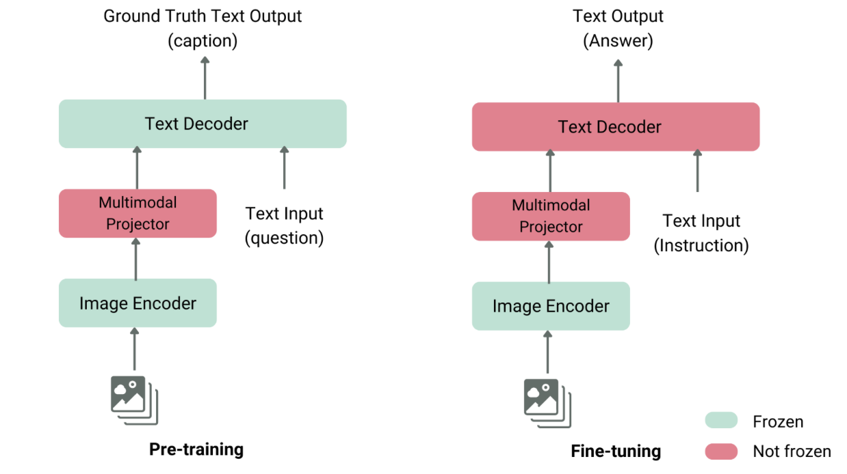
MLLMs: What to Train at Each Stage?
30

Slide 31
MLLMs: Evaluation Methods (1)
After completing the training, we need to ensure the model’s real-world applicability across multiple tasks.
Evaluation Metrics
Benchmark Datasets
Text Generation
Vision-Language Understanding
Audio Understanding
Multimodal Coherence
Text & Vision Tasks
Video & Multimodal Tasks
Audio & Speech
31

Slide 32
MLLMs: Evaluation Methods (2)
Another thing to consider while evaluating MLLMs is how we are going to evaluate the model in general tasks and specific tasks.
General Tasks
Specific Tasks
Multimodal Recognition, Perception, and Reasoning
Trustworthiness: Hallucinations, Bias, Safety, Ethics
Socioeconomic: Cultural Analysis
Natural Science & Engineering: Mathematics, Biology, Code
Medical Tasks
32

Slide 33
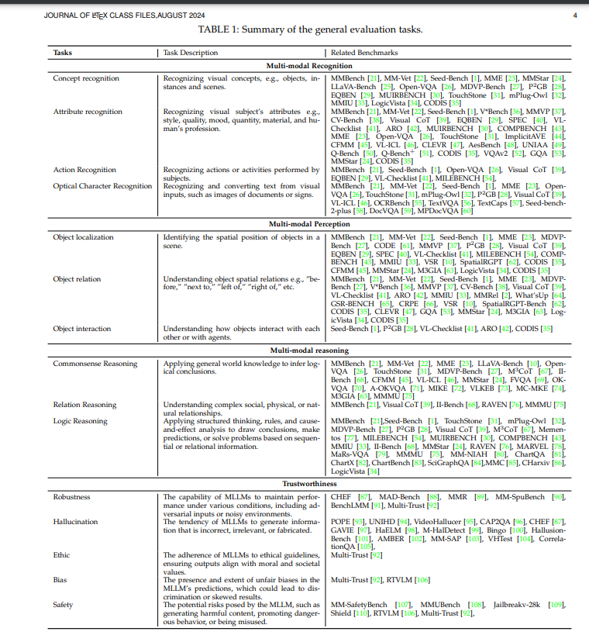
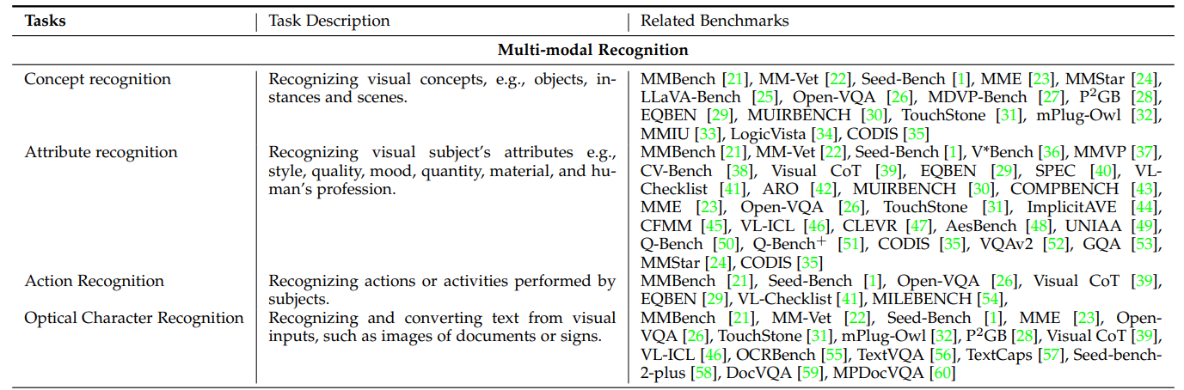
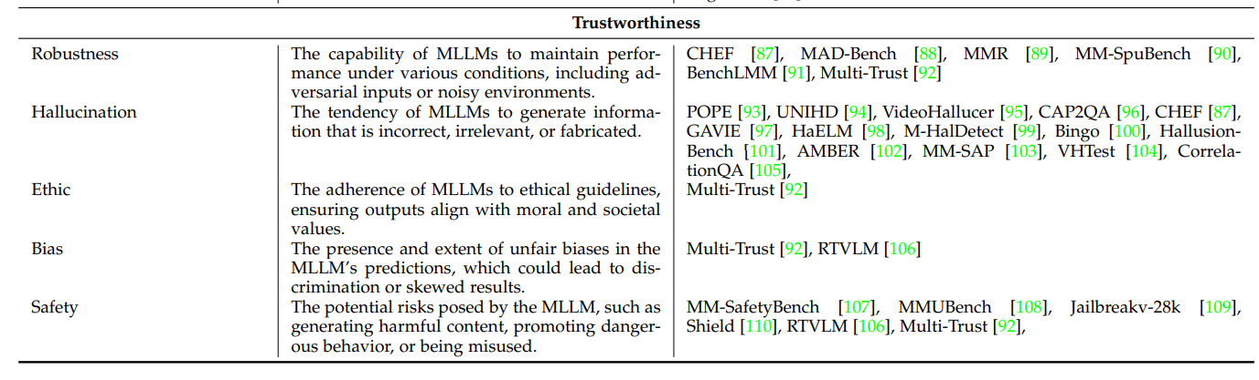
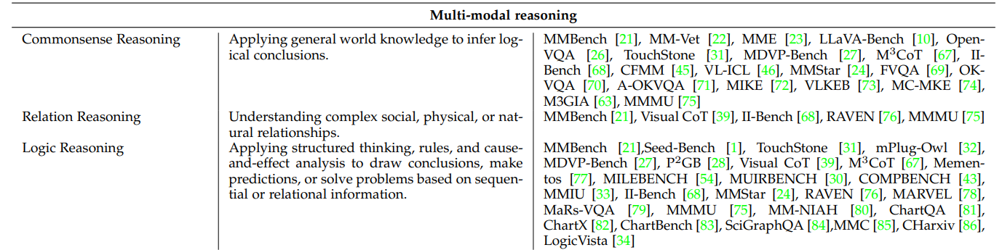
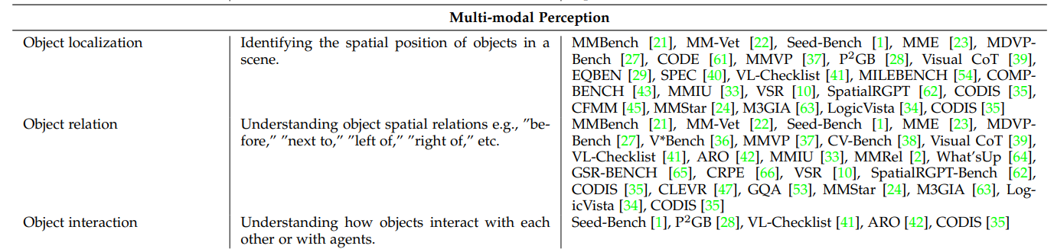
General Tasks
33

Slide 34

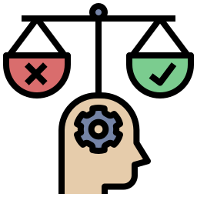

General Tasks
Trustworthiness: Hallucinations, Bias & Safety
Hallucinations
Generating false or misleading information
Bias
Reinforcing stereotypes and/or having skewed representation of cultures/demographics
Generating harmful/unethical content, exposing private data, vulnerability to adversarial attacks
Safety
34

Slide 35
General Tasks
Trustworthiness: Hallucinations, Bias & Safety
Hallucinations
Uncertainty quantification and confidence scoring, fact-checking with retrieval based methods
Hallucinations
Diverse and balanced training data, implementation of bias-sensitive loss functions
Bias
Bias
Adversarial training and implementation of NSFW filters
Safety
Safety
35

Slide 36
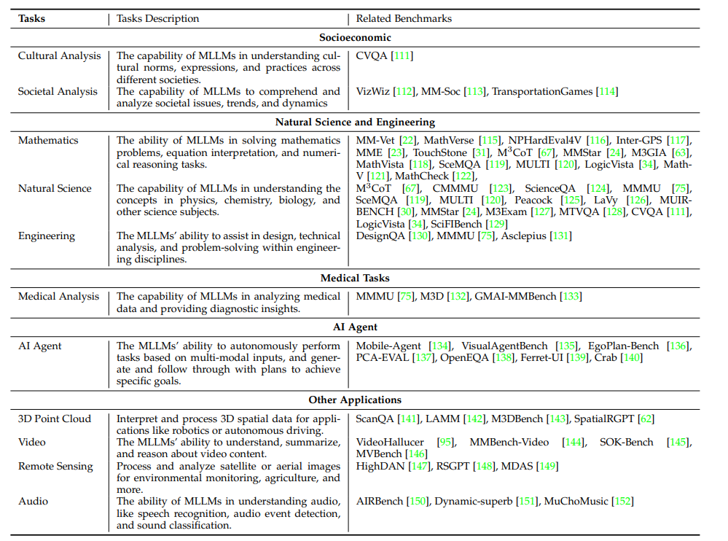
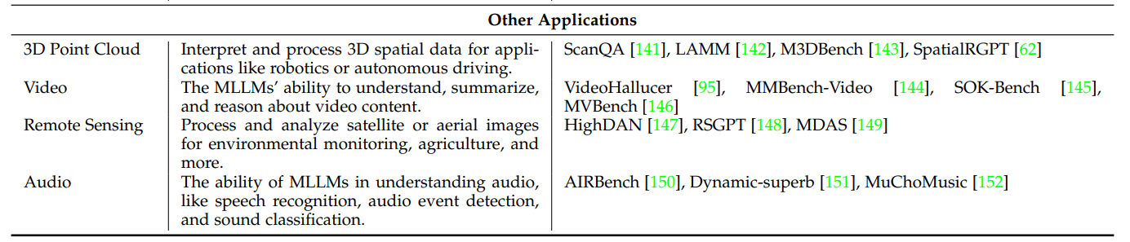
Specific Tasks
36

Slide 37
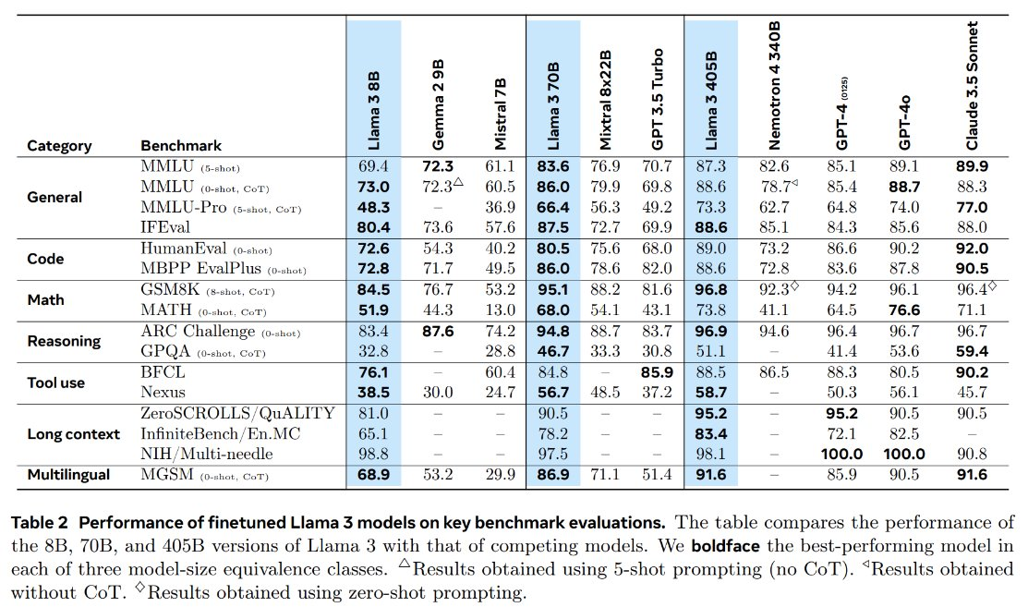
Specific Tasks
37

Slide 38
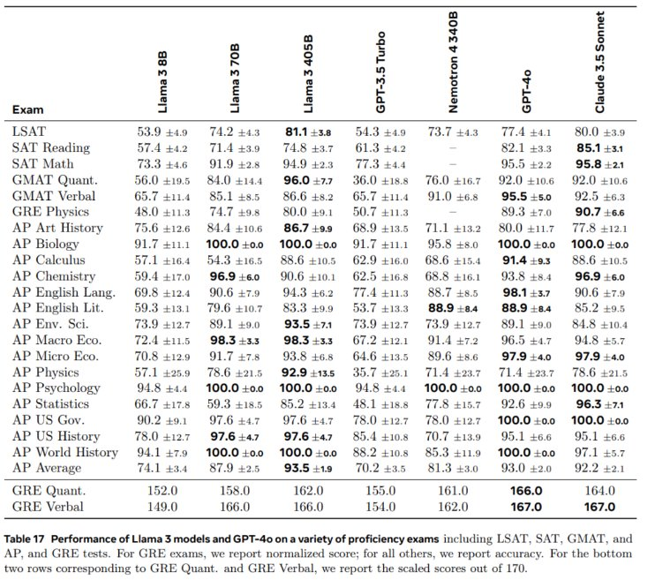
Specific Tasks
38

Slide 39
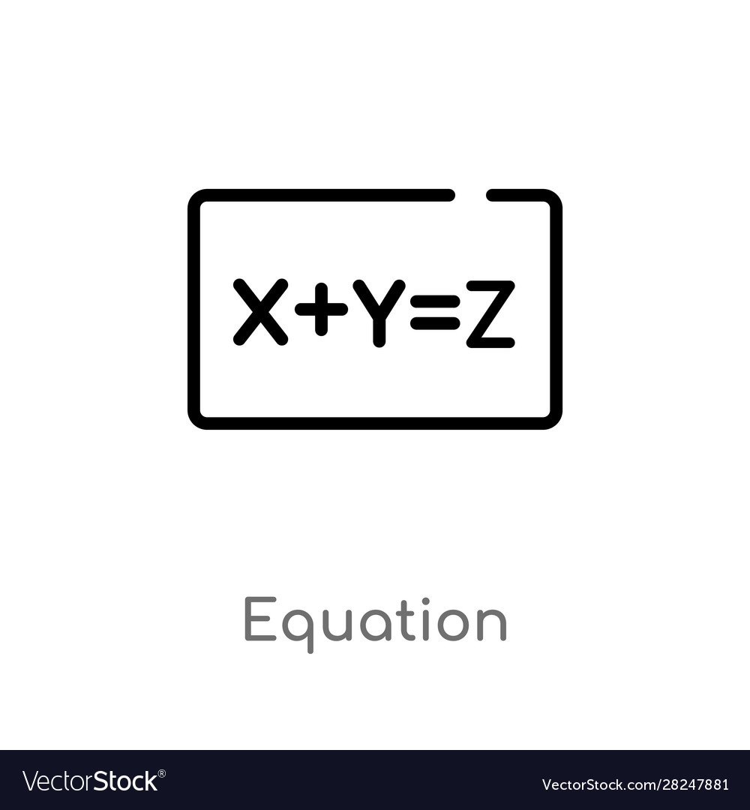


MLLMs: Different Types of Evaluation Methods
There are three main approaches to evaluation:
1
Metric-based evaluation
Automated metrics measure performance based on benchmarks
2
Human-based evaluation
Experts or crowd workers assess model responses
3
Model-based evaluation and LLM-as-judge
Large frontier models, or specialized models, assess other models
39

Slide 40
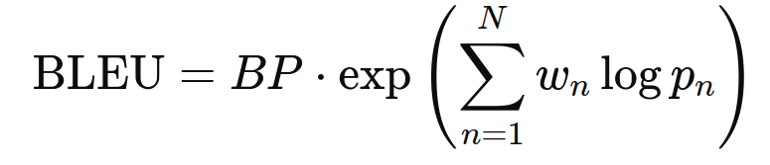
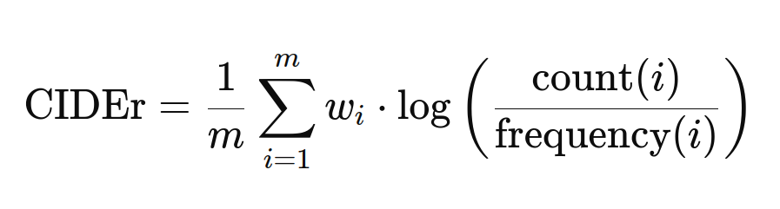
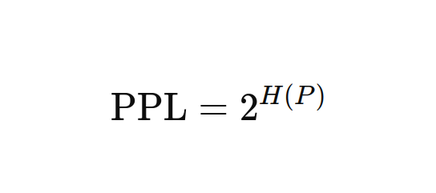
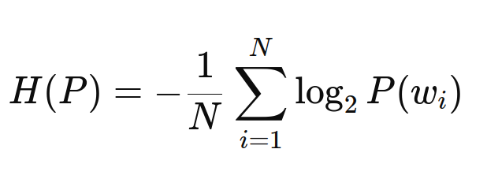
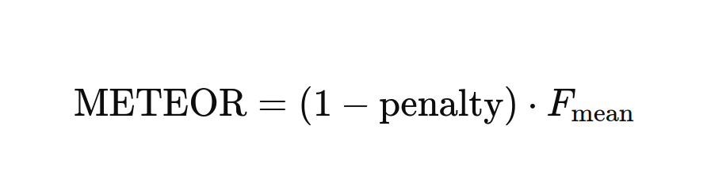
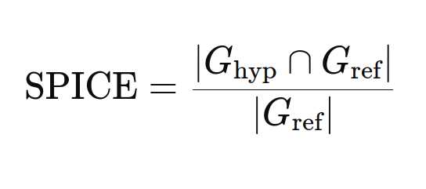
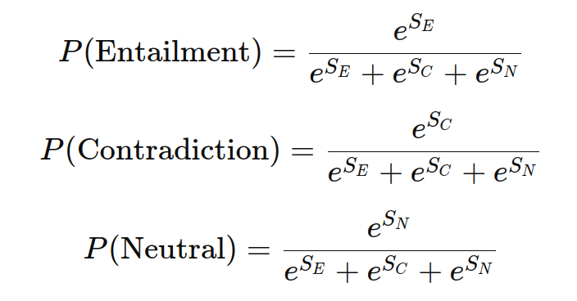
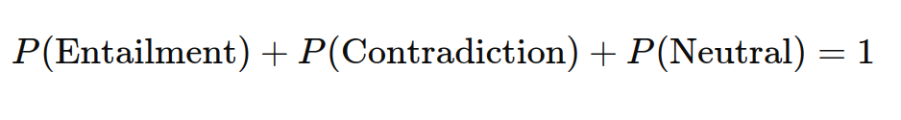
Metric-based
MLLMs: Evaluation Metrics (1)
Metric-based evaluation uses numerical, objective metrics for comparison.
Works well for classification, translation, and retrieval tasks
These include the classification “classics”: Accuracy, Precision, Recall, F1-Score…
Machine Translation, Text Summarization, Image Captioning, ...
Bilingual Evaluation Understudy
40

Slide 41
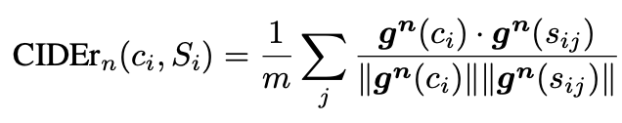
Metric-based
MLLMs: Evaluation Metrics (2)
Metric-based evaluation uses numerical, objective metrics for comparison.
Works well for classification, translation, and retrieval tasks
These include the classification “classics”: Accuracy, Precision, Recall, F1-Score…
Machine Translation, Text Summarization, Image Captioning, ...
Consensus-based Image Description Evaluation
41

Slide 42
Human-based
MLLMs: Human-Based Evaluation
Human-based evaluation is used to asses models through direct human judgment.
It helps evaluate aspects that automated scores miss!
Likert Scale: Evaluating some model characteristic from 1 to 5.
A/B Testing: Comparing two versions of the model.
Expert Review: The model is evaluated by domain experts.
Very Time Consuming!
Very Expensive!
Potential biased evaluation
42

Slide 43
GPT-based
MLLMs: Model-Based Evaluation
Model-based evaluation is based on using models (often large models like GPT-4, or task-specific models trained to replicate human assessments) to assess the quality of the outputs (e.g., use an LLM as a judge).
Good alternative for automated assessment that is consistent across a variety of tasks. It is also reference-free!
Cost-effective!
Cannot fully replace human evaluation
Quick feedback
May inherit model biases
Systematic Evaluation
Difficulties with domain-specific tasks
43
May inherit biases from the GPT models used as evaluators
Requires careful prompt engineering for reliable results
Cannot fully replace human evaluation for nuanced understanding
May struggle with highly specialized or technical content

Slide 44
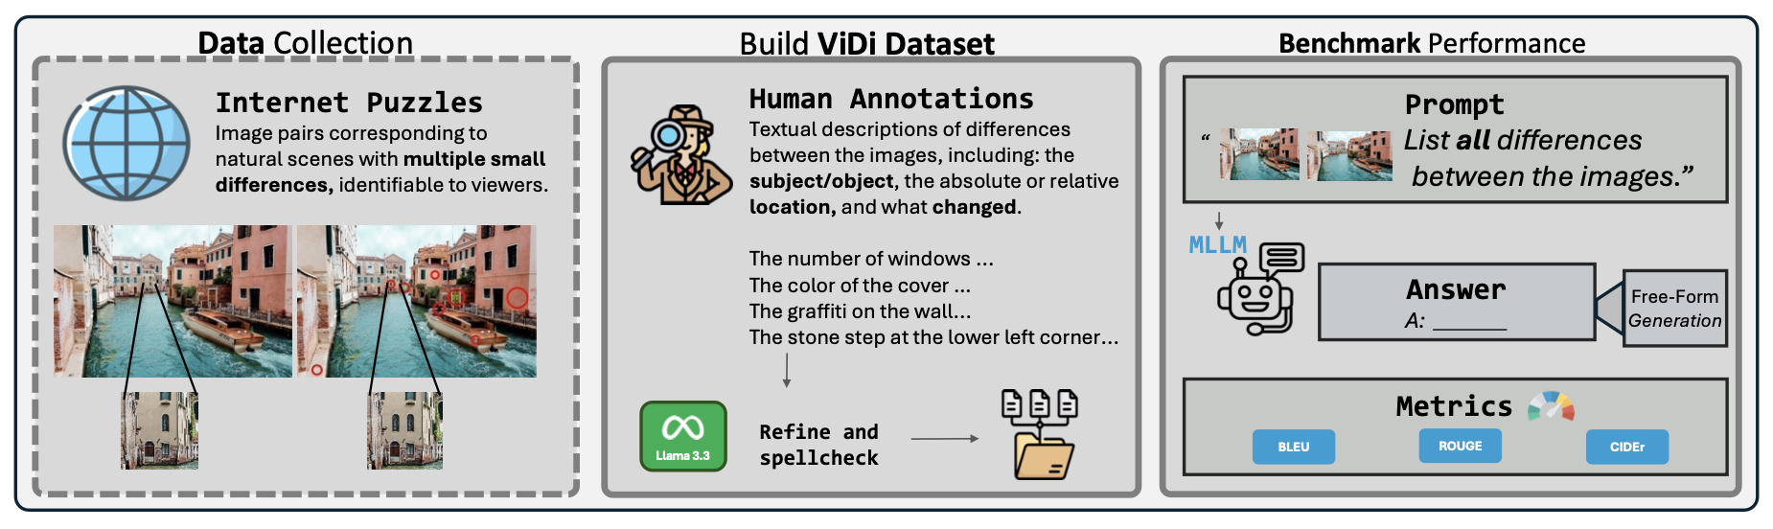
Current MLLM Performance on Challenging Bechmarks (1)
44
May inherit biases from the GPT models used as evaluators
Requires careful prompt engineering for reliable results
Cannot fully replace human evaluation for nuanced understanding
May struggle with highly specialized or technical content

Slide 45
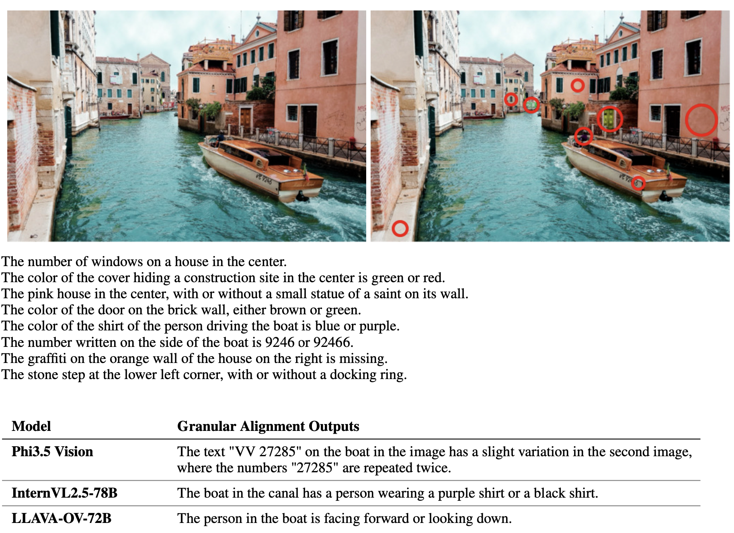
Current MLLM Performance on Challenging Bechmarks (2)
Despite popular enthusiasm, MLLMs remain in the early stages of development, with their visual comprehension significantly trailing their linguistic abilities.
45
May inherit biases from the GPT models used as evaluators
Requires careful prompt engineering for reliable results
Cannot fully replace human evaluation for nuanced understanding
May struggle with highly specialized or technical content

Slide 46
Current Frontier
Multilinguality and cultural awareness
Maybe go as far as to treat language as images (e.g., the PIXEL model with text renderings)
Non-literal understanding (e.g., humor)
Requires deeper multimodal interaction
Required modeling social and world-level knowledge
Physical understanding
Predicting and explaining physical actions in the world (i.e., world models) will become of increasing importance as we create embodied agents
Multimodality and interaction, reasoning, …
AI agents like CogAgent or OmniAct
Multimodal models that reason over results of tool use (e.g., cropping models)
Learning to act in environments with rich contexts, action spaces, and long-term rewards (e.g., video games, but also web applications and form-based information systems)

Slide 47
Exercise Time
https://github.com/merveenoyan/smol-vision/tree/main
(see the notebook "Fine-tune PaliGemma")

Slide 48

Thank you!

